Slide 1
Potenzgesetze
www.matheportal.wordpress.com

Slide 2
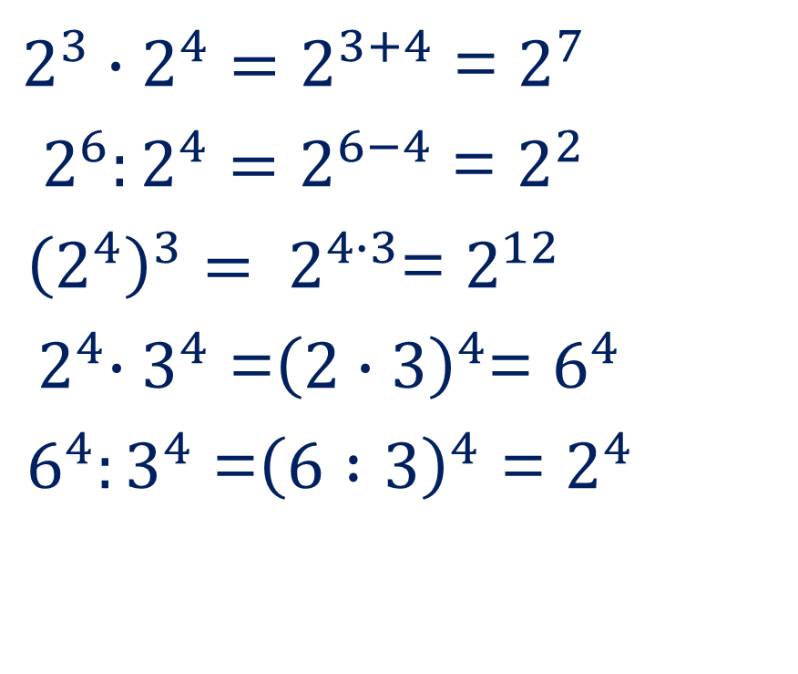
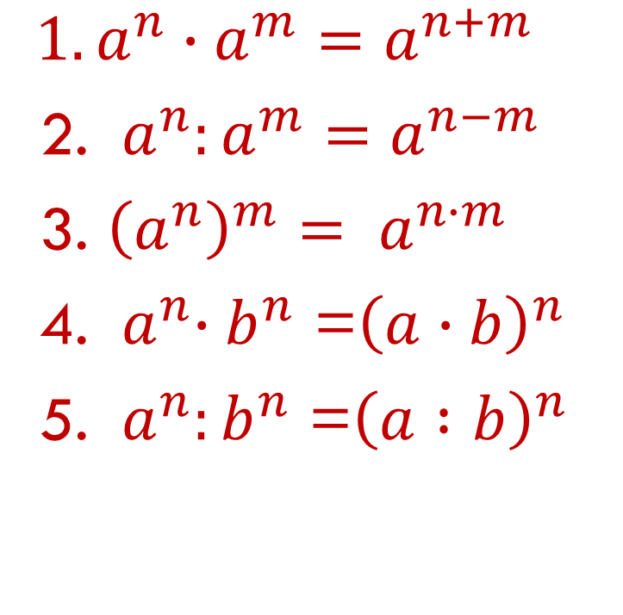
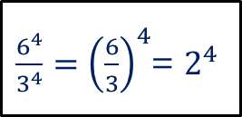
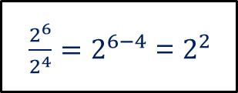
Die 5 Potenzgesetze:
${1. a}^{n}∙a^{m}=a^{n+m}$
2. ${ a}^{n}:a^{m}=a^{n−m}$
3. ${\left(a^{n}\right)}^{m}= a^{n∙m}$
4. ${ a}^{n}∙b^{n}$ =${\left(a∙b\right)}^{n}$
5. ${ a}^{n}:b^{n}$ =${\left(a :b\right)}^{n}$
$2^{3}∙2^{4}=2^{3+4}$ = $2^{7}$
${ 2}^{6}:2^{4}=2^{6−4}$ = $2^{2 }$
${\left(2^{4}\right)}^{3}= 2^{4∙3}$= $2^{12 }$
${ 2}^{4}∙3^{4}$ =${\left(2∙3\right)}^{4}$= $6^{4 }$
$6^{4}:3^{4}$ =${\left(6 :3\right)}^{4}$ = $2^{4}$
$\frac{2^{6}}{2^{4}}=2^{6−4}$ = $2^{2 }$
$\frac{6^{4}}{3^{4}}=$ ${\left(\frac{6}{3}\right)}^{4}$= $2^{4 }$

